Slide 1

Fractions Interactive Notebook
Your Name
Class 8.4
Mrs Riksman
Term 2 Semester 1
1

Slide 2
Contents
Glossary
Page
Date
Description
Word
Description
4-5
6-7
8-9
10-11
18/6
19/6
24/6
26/6
Introduction to Fractions
Equivalent Fractions
Adding and Subtracting Fractions
Multiplying Fractions

Slide 3
Title:
Date:
Tasks
24
7
30
Essential Question
Questions
Notes
Summary
4
5

Slide 4
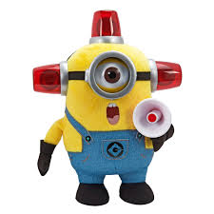
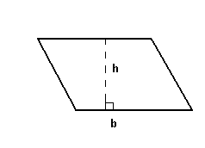

10 Quick Questions
1. 23 x 5 =
2. 2165 – 889 =
3. 1912 + 796 =
4. 5624 ÷ 8 =
5. Round 103.874 to 2 d.p
6. Round 387 to the nearest hundred
7. $4c x 3d$
8. $\frac{1}{7} of 63$
9. Find the perimeter
10. Find the area
7cm
3cm
4m
8m

Slide 5
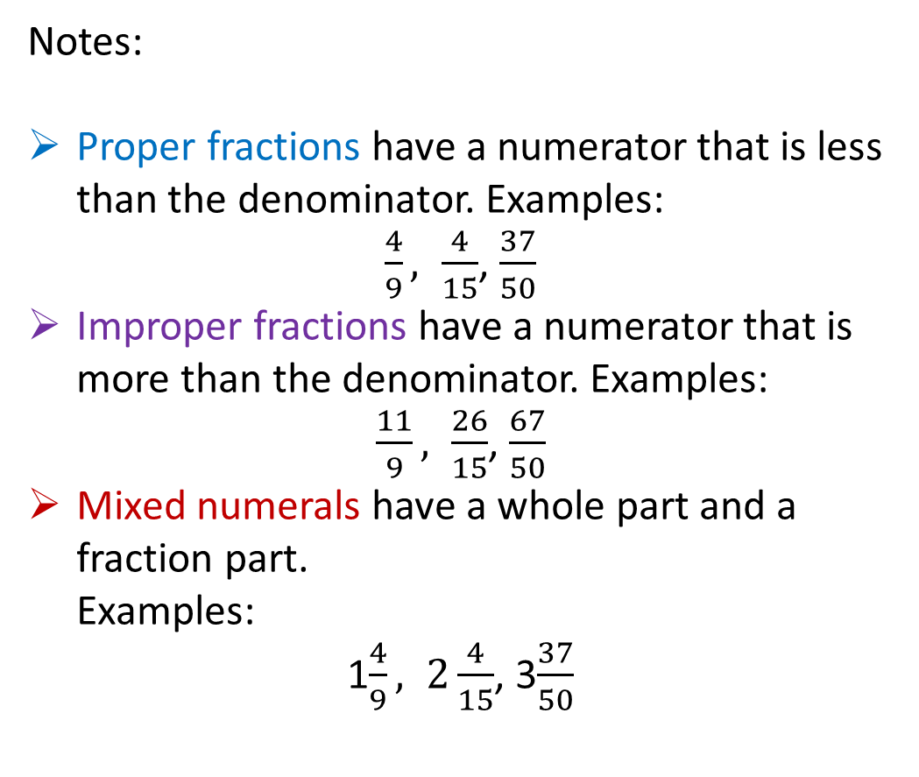
24
7
30
Title: Introduction to Fractions
Date: 18/6/15
EQ : Identify the three types of fractions proper, improper and mixed numerals and how to convert between them
Question:
What is a proper fraction?
What is an improper fraction?
What is a mixed numeral?
Notes:
Proper fractions have a numerator that is less than the denominator. Examples:
$\frac{4}{9}, \frac{4}{15}$, $\frac{37}{50}$
Improper fractions have a numerator that is more than the denominator. Examples:
$\frac{11}{9}, \frac{26}{15}$, $\frac{67}{50}$
Mixed numerals have a whole part and a fraction part.
Examples:
1$\frac{4}{9}, 2\frac{4}{15}$, 3$\frac{37}{50}$
5

Slide 6

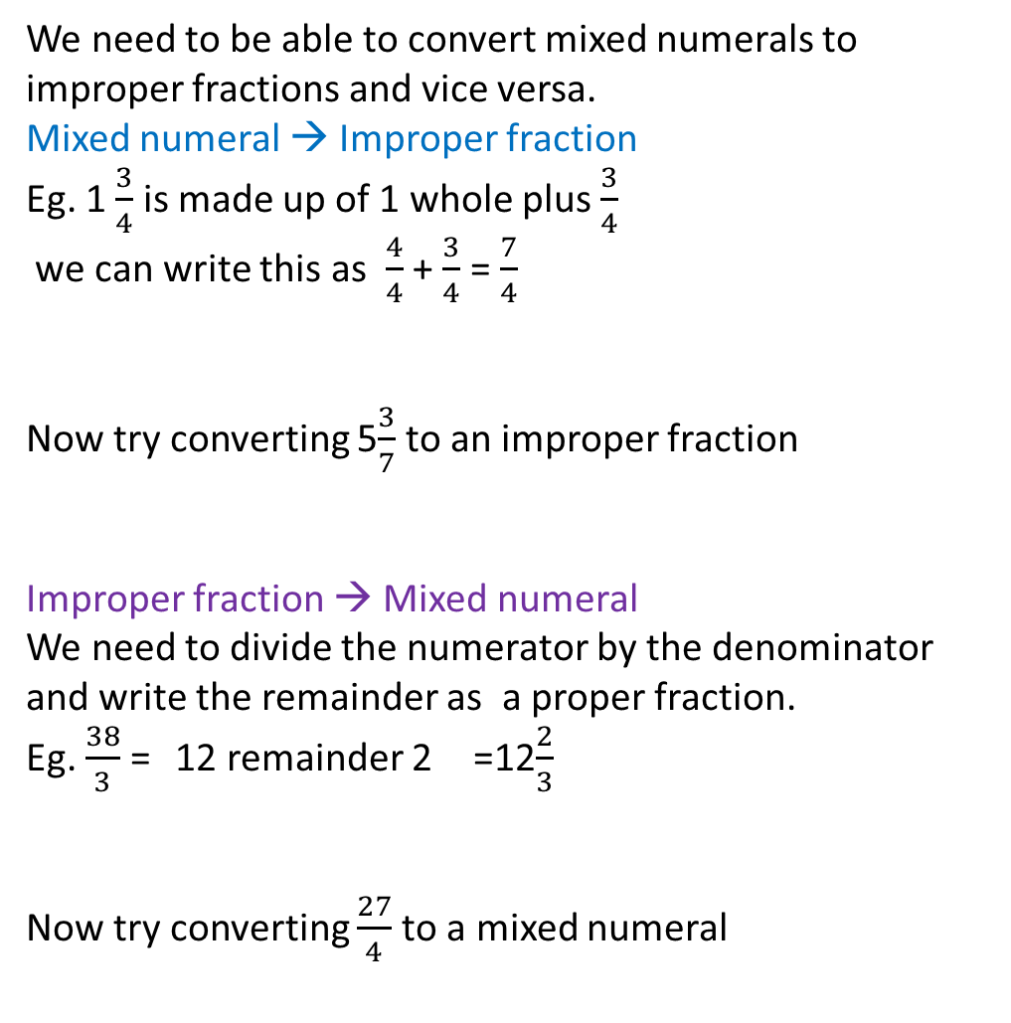
Question:
Notes:
How do we convert a mixed numeral to an improper fraction?
How do we convert an improper fraction to a mixed numeral?
We need to be able to convert mixed numerals to improper fractions and vice versa.
Mixed numeral → Improper fraction
Eg. 1 $\frac{3}{4}$ is made up of 1 whole plus $\frac{3}{4}$
we can write this as $\frac{4}{4}$ + $\frac{3}{4}$ = $\frac{7}{4}$
Now try converting 5$\frac{3}{7}$ to an improper fraction
Improper fraction → Mixed numeral
We need to divide the numerator by the denominator and write the remainder as a proper fraction.
Eg. $\frac{38}{3}$ = 12 remainder 2 =12$\frac{2}{3}$
Now try converting $\frac{27}{4}$to a mixed numeral

Slide 7

10 Quick Questions
1. 23 x 8 =
2. 2429 - 761 =
3. 2314 + 827 =
4. 4872 ÷ 8 =
5. Round 3.9271 to 2 d.p
6. Round 526 to the nearest ten
7. $2a x 6b x c$
8. $\frac{2}{3} of$18
9. Find the perimeter
10. Find the area
12mm
4mm
3cm
9cm

Slide 8
24
7
30
Title: Equivalent fractions
Date: 19/6/15
EQ : What is an equivalent fraction and how can it be calculated?
Question:
What is an equivalent fraction?
What is a common factor and can we use it to find the equivalent fraction
Notes:
Different fractions that are equal in size are called equivalent fractions.
In its simplest form an equivalent fraction has the lowest possible denominator.
A number that goes into both the numerator and the denominator is called a common factor.
In its simplest form, a fraction has no common factors in its numerator and denominator (apart from 1).
7

Slide 9

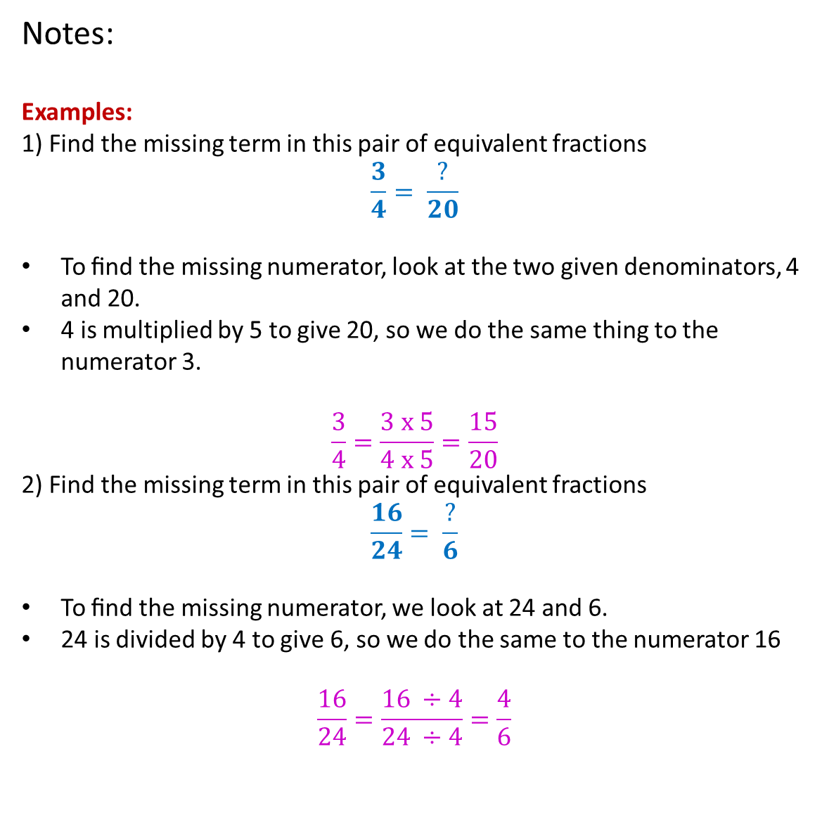
Question:
Notes:
Examples:
1) Find the missing term in this pair of equivalent fractions
$$\frac{3}{4}= \frac{?}{20}$$
To ﬁnd the missing numerator, look at the two given denominators, 4 and 20.
4 is multiplied by 5 to give 20, so we do the same thing to the numerator 3.
$$\frac{3}{4}=\frac{3 x 5}{4 x 5}=\frac{15}{20}$$
2) Find the missing term in this pair of equivalent fractions
$$\frac{16}{24}= \frac{?}{6}$$
To ﬁnd the missing numerator, we look at 24 and 6.
24 is divided by 4 to give 6, so we do the same to the numerator 16
$$\frac{16}{24}=\frac{16 ÷4}{24 ÷4}=\frac{4}{6}$$

Slide 10
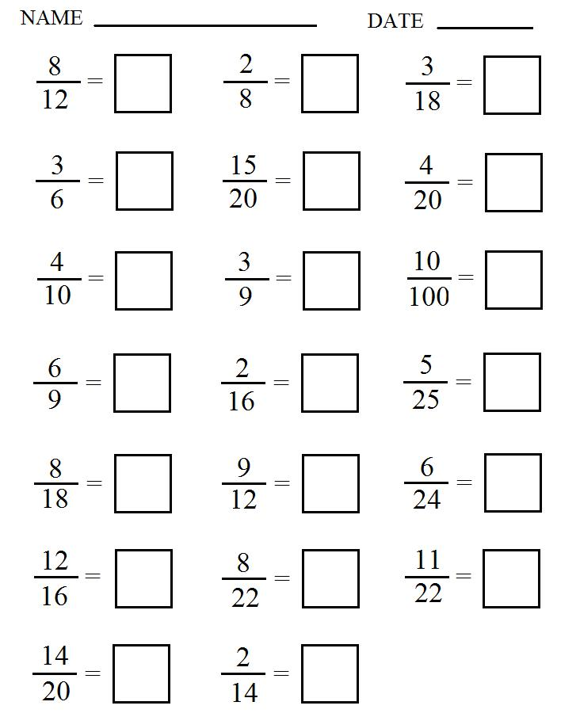

Slide 12
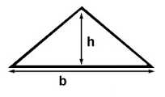

10 Quick Questions
1. 43 x 8 =
2. 3268 – 892 =
3. 3817 + 1492 =
4. 5648 ÷ 8 =
5. Round to 0.98725 3 d.p
6. Write 3 hundredths as a fraction
7. $\frac{4}{5} of 45$
8. Write a fraction equivalent to $\frac{2}{3}$
9. Find the perimeter
10. Find the area
15cm
11cm
9m
12m

Slide 13

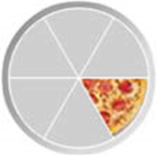

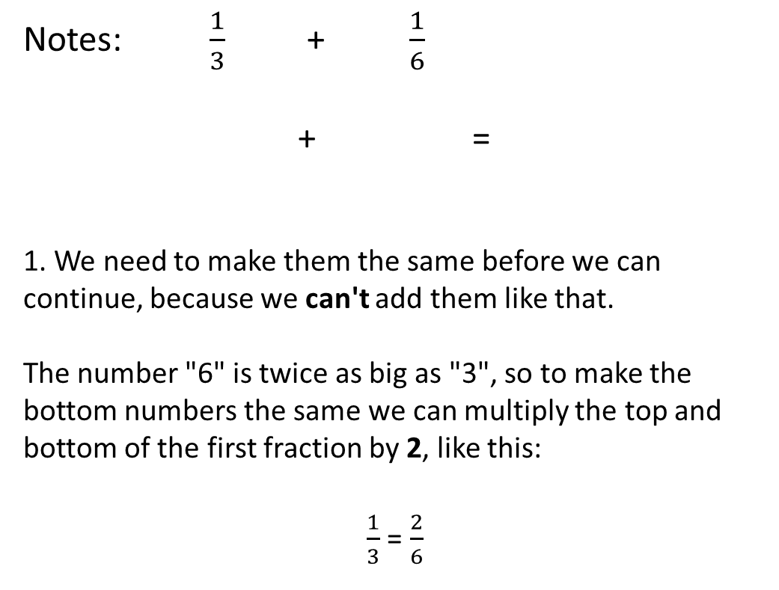
24
7
30
Title: Adding and Subtracting Fractions
with Related Denominators
Date: 24/6/15
EQ : Explain the process of adding and subtracting fractions with the related denominators
Question:
Notes: $\frac{1}{3}$+ $\frac{1}{6}$
+ =
1. We need to make them the same before we can continue, because we can't add them like that.
The number "6" is twice as big as "3", so to make the bottom numbers the same we can multiply the top and bottom of the first fraction by 2, like this:
$\frac{1}{3}$ = $\frac{2}{6}$
What is the first step in the process?
How do we convert the numerator and denominator?
x2
x2
9

Slide 14
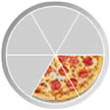
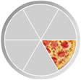
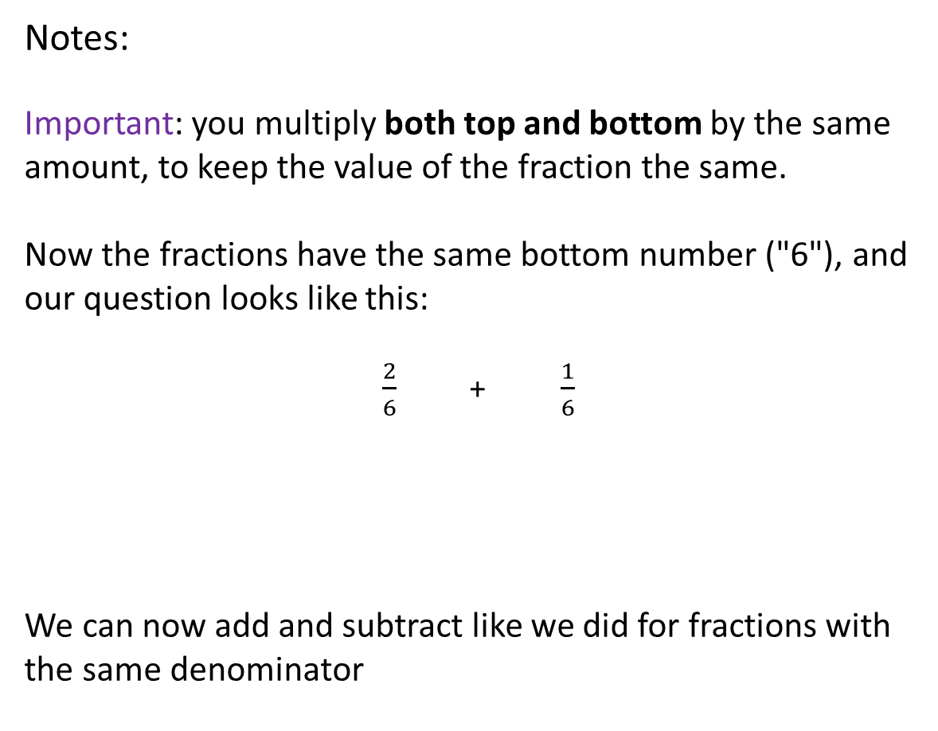
Question:
Notes:
Important: you multiply both top and bottom by the same amount, to keep the value of the fraction the same.
Now the fractions have the same bottom number ("6"), and our question looks like this:
$\frac{2}{6}$+ $\frac{1}{6}$
We can now add and subtract like we did for fractions with the same denominator
Why do we multiply both the top and bottom?
What is the final step?
9

Slide 15

10 Quick Questions
1. 54 x 6 =
2. 3819 – 1264 =
3. 3572 + 1768 =
4. 54612 ÷ 6 =
5. Round to 0.98725 2 d.p
6. Write 13 hundredths as a fraction
7. $\frac{3}{7} of 56$
8. Write a fraction equivalent to $\frac{3}{4}$
9. $\frac{3}{7}+ \frac{2}{7}$
10. Find the area
8cm
14cm

Slide 16

10 Quick Questions
1. 62 x 5 =
2. 3362 – 1887 =
3. 3470 + 1768 =
4. 60186 ÷ 6 =
5. Round to 1.98 to 1 d.p
6. Write 5 tenths as a fraction
7. $\frac{5}{9} of 81$
8. Write a fraction equivalent to $\frac{4}{5}$
9. $\frac{1}{3}+ \frac{2}{5}$
10. Find the radius
18cm
8cm

Slide 17
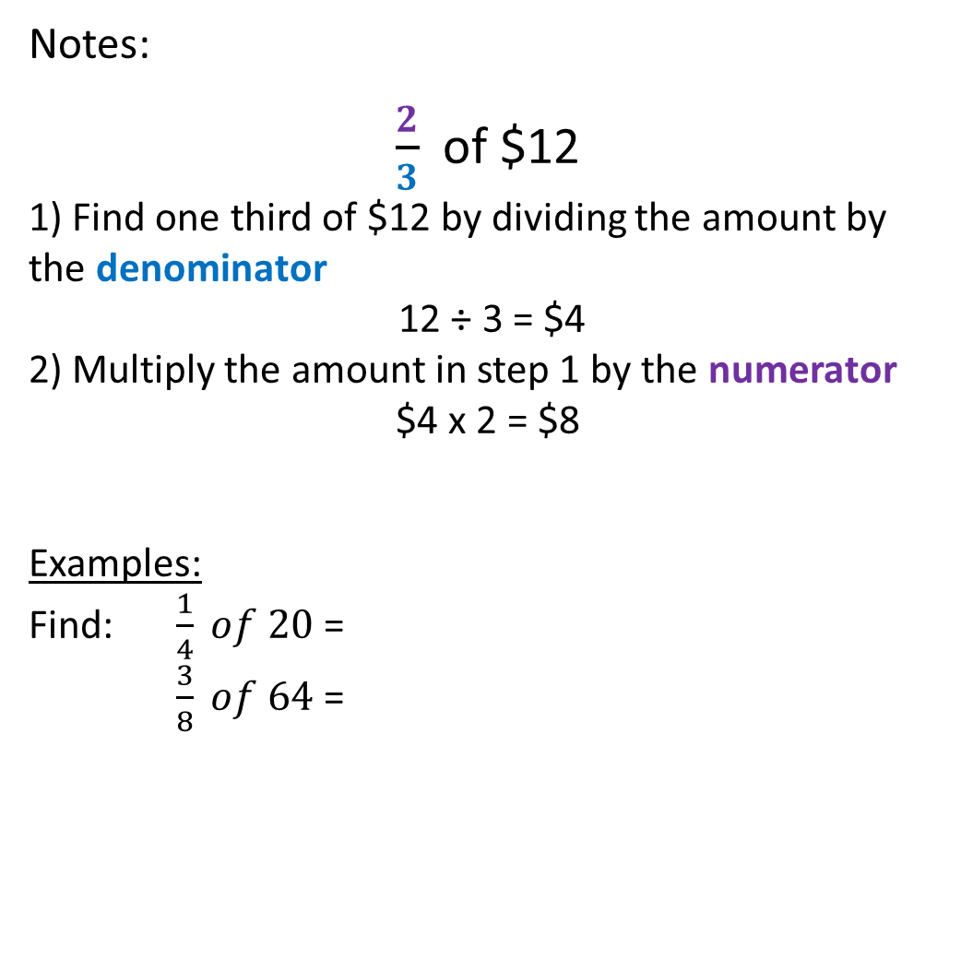
24
7
30
Title: Finding fractions of an amount and
Multiplying Fractions
Date: 26/6/15
EQ : Explain how to find the fraction of an amount and the process of multiplying fractions
Question:
Notes:
$\frac{2}{3}$ of $12
1) Find one third of $12 by dividing the amount by the denominator
12 ÷ 3 = $4
2) Multiply the amount in step 1 by the numerator
$4 x 2 = $8
Examples:
Find: $\frac{1}{4} of 20$ =
$\frac{3}{8} of 64$ =
How do you find a fraction of an amount?
11

Slide 18
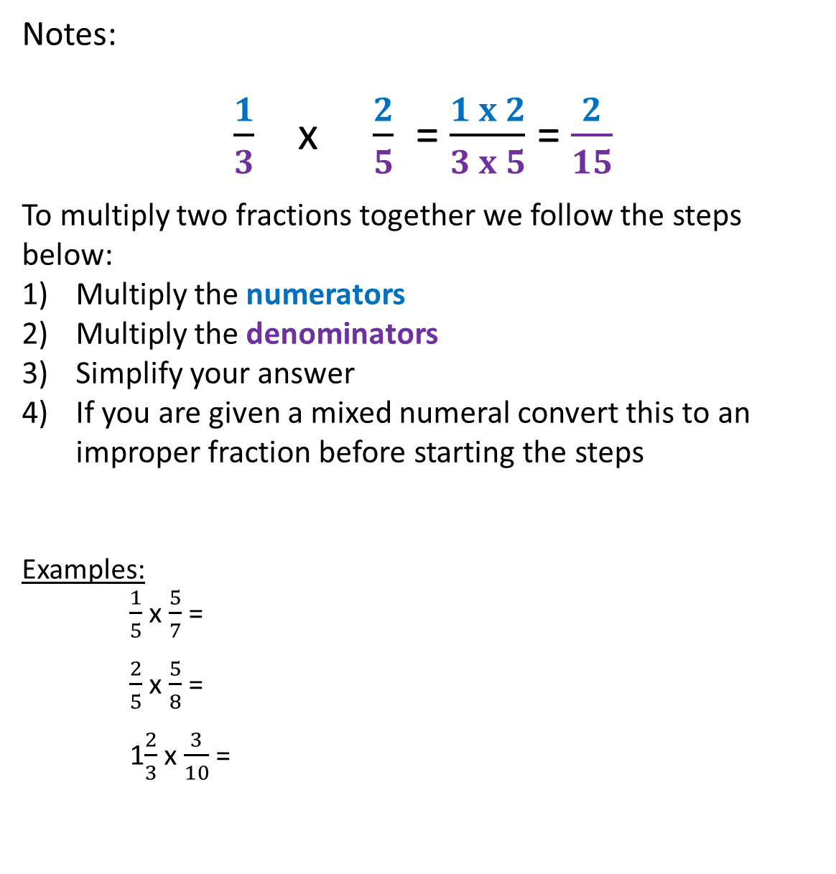
Question:
Notes:
$\frac{1}{3}$ x $\frac{2}{5}$ = $\frac{1 x 2}{3 x 5}$ = $\frac{2}{15}$
To multiply two fractions together we follow the steps below:
Multiply the numerators
Multiply the denominators
Simplify your answer
If you are given a mixed numeral convert this to an improper fraction before starting the steps
Examples:
$\frac{1}{5}$ x $\frac{5}{7}$ =
$\frac{2}{5}$ x $\frac{5}{8}$ =
1$\frac{2}{3}$ x $\frac{3}{10}$ =
What are the steps to multiply two fractions?
11

